Slide 1
Monitoring of ecosystems – Big Data (Remote Sensing Data), Artificial Intelligence (AI), Machine Learning (ML) and Deep Learning techniques
Satvik Madayi, Amogh Saagar Grade 10
4/12/2022
LAKE 2022: Conservation of wetlands: ecosystem-based adaptation of climate change, December 28-30, 2022

Slide 2
Introduction
Ecosystems are geographical areas where different flora and fauna co-exist with organisms to maintain life.
They serve a great function in all fields of human development. They essentially form the basis of human existence.
Forests cover approximately 30% of global land area and are dominant terrestrial ecosystems harbouring 90% of terrestrial biodiversity.
Forests are vital for proper functioning of our planet as they provide several critical functions for sustaining life, such as protective functions and environmental services.
For instance:
They provide clean, breathable air,
Play a major role in global food security by supporting pollinators, natural predators of agricultural pests,
Are an important source of medicinal plants
Supply about 40% of global renewable energy (biofuels),
4/12/2022
LAKE 2022: Conservation of wetlands: ecosystem-based adaptation of climate change, December 28-30, 2022

Slide 3
Problems faced by Ecosystems
Globally, forests are undergoing rapid degradation due to exploitation for timber, agriculture expansion, and urbanization. Impacts of climate change, such as wildfires, are further contributing to global forest degradation.
In the last 25 years, 129 million hectares of forest area were lost globally.
It is predicted that the current global trend of forest decline and carbon loss will continue in the near future.
Despite the benefits the forest provides and the kind of threats it is experiencing, the forest sector is still using traditional techniques like pen and paper to conduct forest inventories
Such traditional methods pose many drawbacks, like the introduction of personal bias, slowing data collection and analysis, and lack of scalability of the approach.
4/12/2022
LAKE 2022: Conservation of wetlands: ecosystem-based adaptation of climate change, December 28-30, 2022

Slide 4
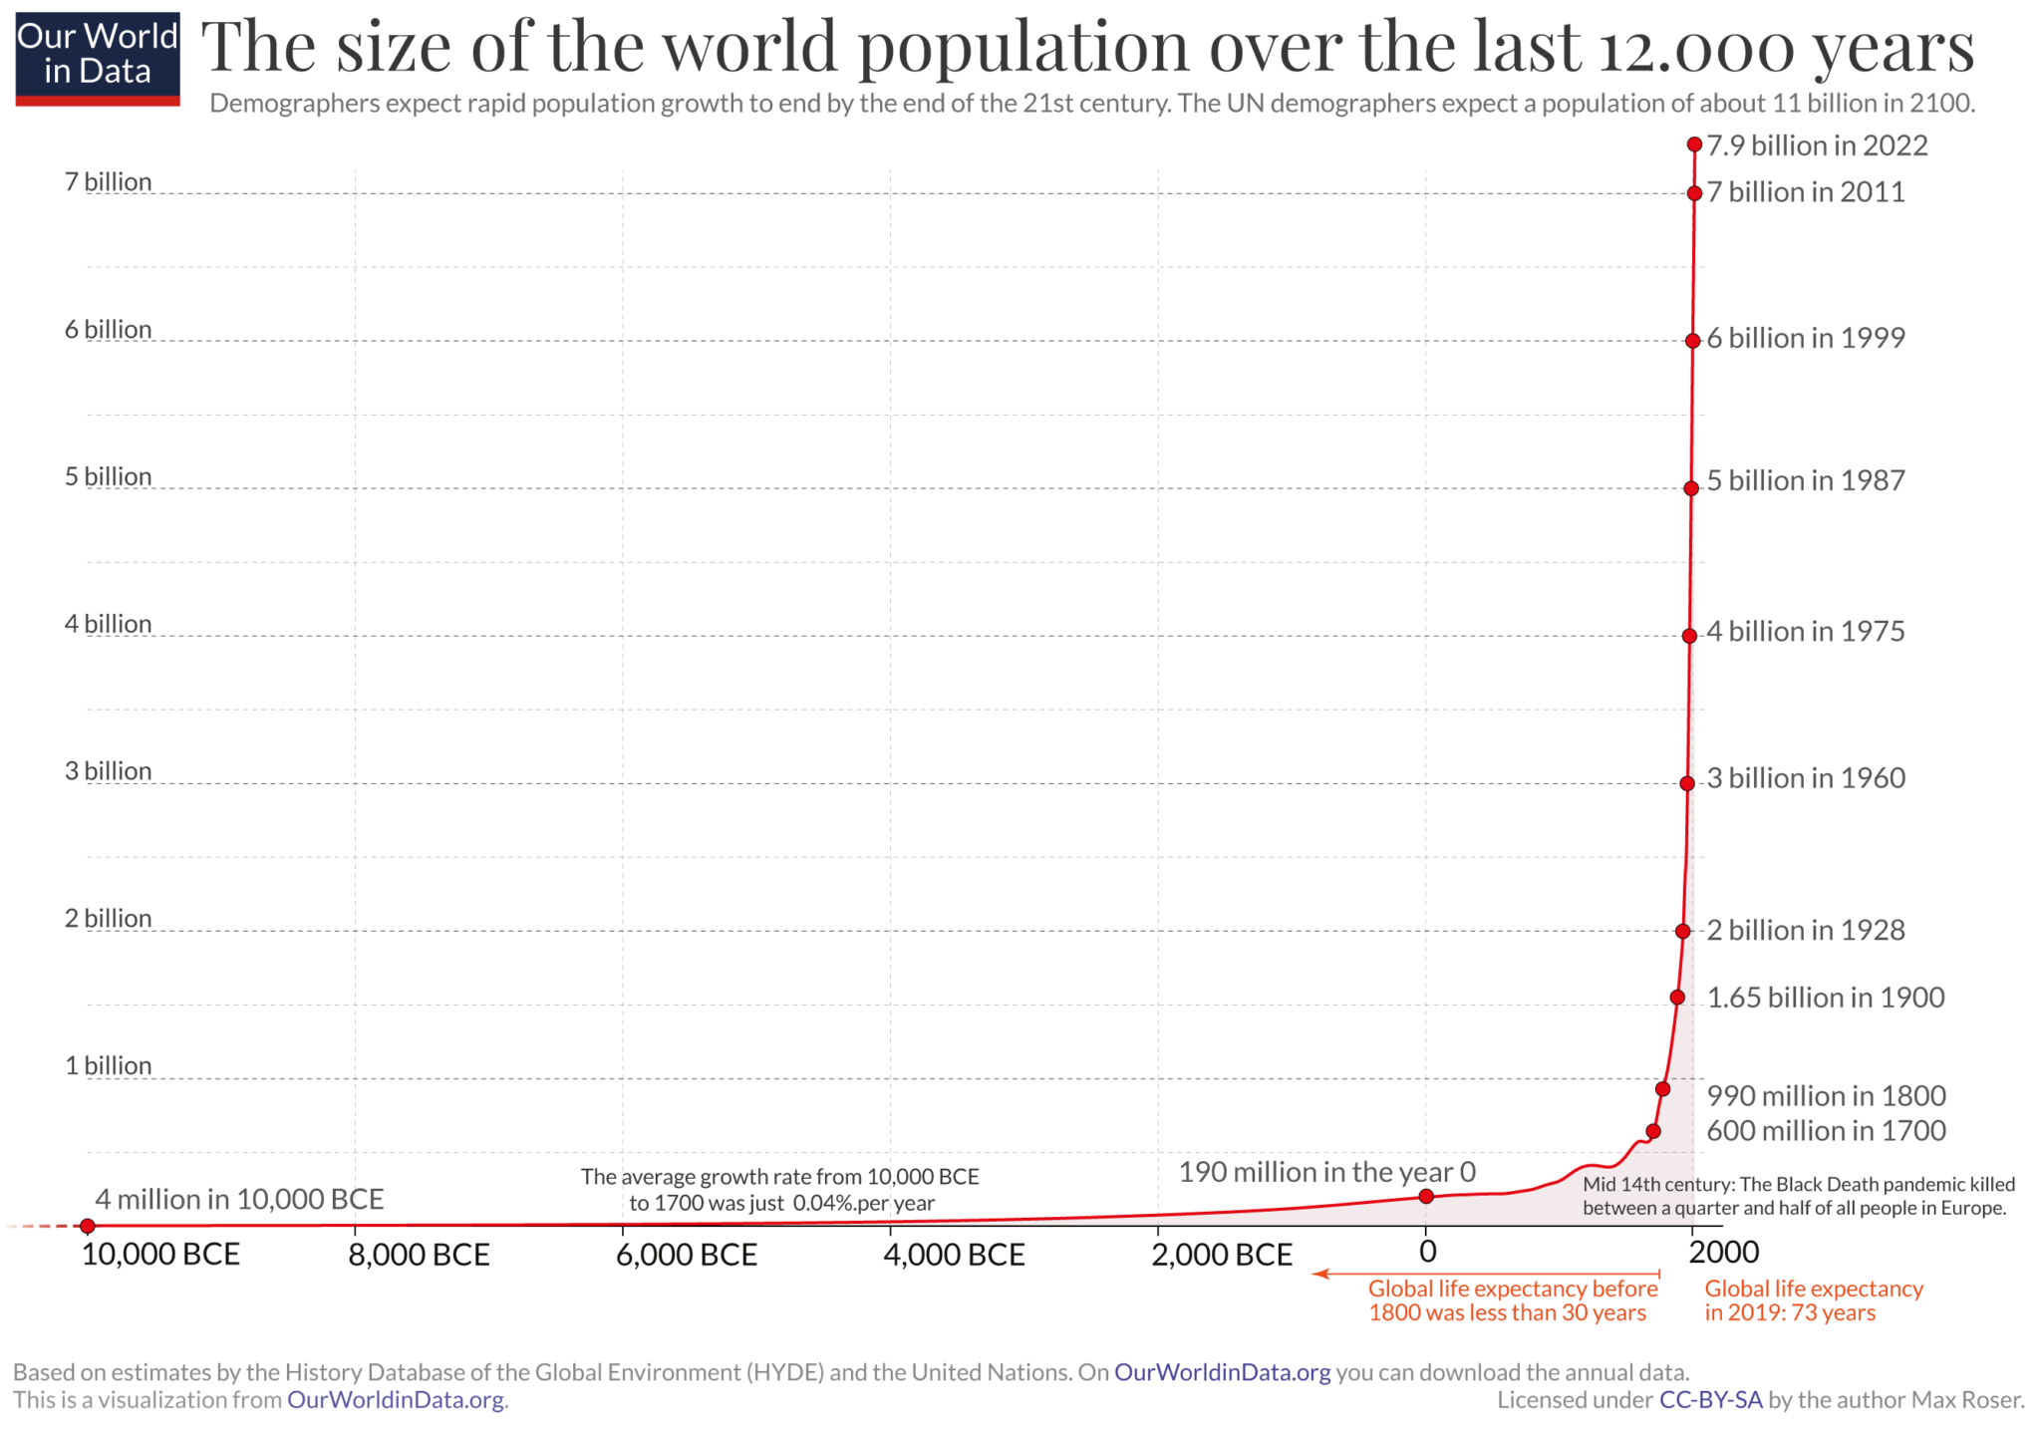
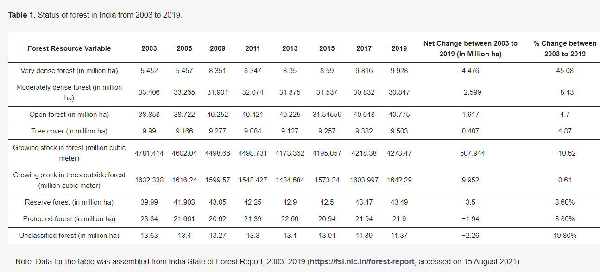
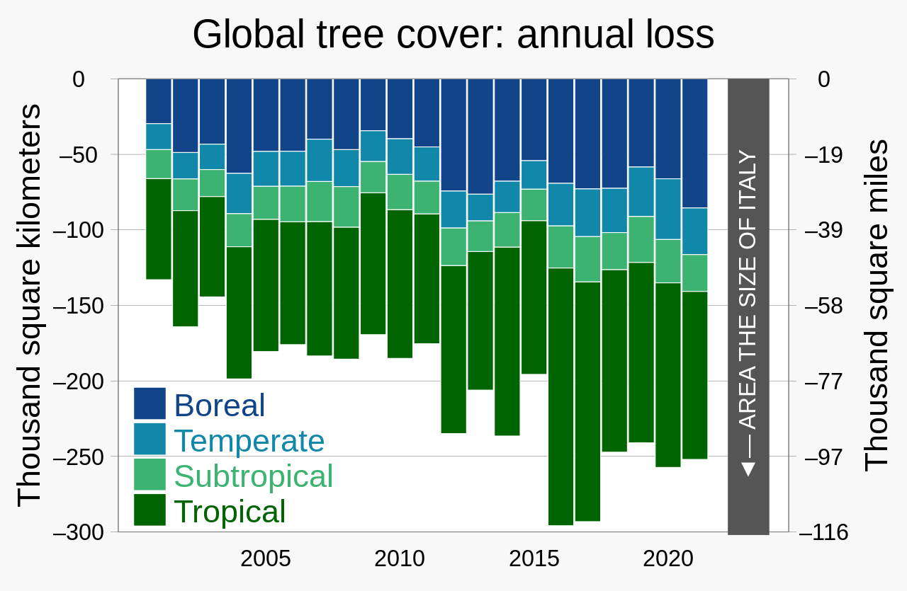
Fig: Global Population in the last 12,000 years$.^{(2)}$
Fig: Status of forests in India from 2003-2019
Fig: Annual global tree cover loss$.^{(1)}$
(1)- https://upload.wikimedia.org/wikipedia/commons/1/1f/20210331_Global_tree_cover_loss_-_World_Resources_Institute.svg
(2)- https://ourworldindata.org/uploads/2022/03/Annual-World-Population-since-10-thousand-BCE-2048x1441.png
4/12/2022
LAKE 2022: Conservation of wetlands: ecosystem-based adaptation of climate change, December 28-30, 2022

Slide 5
Ecological Monitoring
Ecological monitoring is integral to environmental management and biological conservation.
As the need for monitoring species, habitats, and ecosystems increases, so too do the ways in which scientists and managers involve personnel and technology to collect, process, and analyse both samples and data.
With advances in technology and the capacity to collect big datasets, data processing has become a major bottleneck that requires novel solutions.
Under such circumstances, scientists and managers may need access to large teams of people with the skills to enable data processing, or computer intelligence may need to fill this gap. Both techniques are already being utilized, by harnessing people power through citizen science and computing power through artificial intelligence (AI).
4/12/2022
LAKE 2022: Conservation of wetlands: ecosystem-based adaptation of climate change, December 28-30, 2022

Slide 6
Conventional Ecological Monitoring
Ecological monitoring is an important scientific practice of taking systematic, repeated measurements of environmental conditions, using the same methods in the same places over time so long-term comparisons can be made.
Monitoring can be passive, or question driven. In passive monitoring, data is collected out of curiosity. Standardized monitoring protocols may still be used so the data can be applied to answer questions later.
Question-driven monitoring projects are designed to answer a specific question or questions. Both kinds of monitoring can be conducted by scientists or citizen scientists.
Conventional methods of ecological monitoring involve hand picked data, surveying, inventory etc. which are often slow and time consuming which require a lot of manual work and cannot be scaled to large regions.
4/12/2022
LAKE 2022: Conservation of wetlands: ecosystem-based adaptation of climate change, December 28-30, 2022

Slide 7
Conservation of Ecosystems using modern methods
It becomes fundamental to monitor these resources and to know exactly how they are changing. This task easily becomes hard to do manually.
The most common way to solve this issue is to automate it. There have been several machine learning models developed for these purposes. These are most commonly paired with a UAV (unmanned aerial vehicle) or a drone which flies over these areas to get raw data, which is then processed using these models.
A more novel approach was to take raw data from satellites rather than these drones which helps cover more area in less time. The ocean is mapped through USV (unmanned surface vehicles). These methods prove to be more efficient and accurate than conventional methods like citizen science and manual survey due to more processing per unit time as well as the limited bias that may affect the results.
Some have also taken a new initiative by implementing citizen science along with these newer methods.
4/12/2022
LAKE 2022: Conservation of wetlands: ecosystem-based adaptation of climate change, December 28-30, 2022

Slide 8
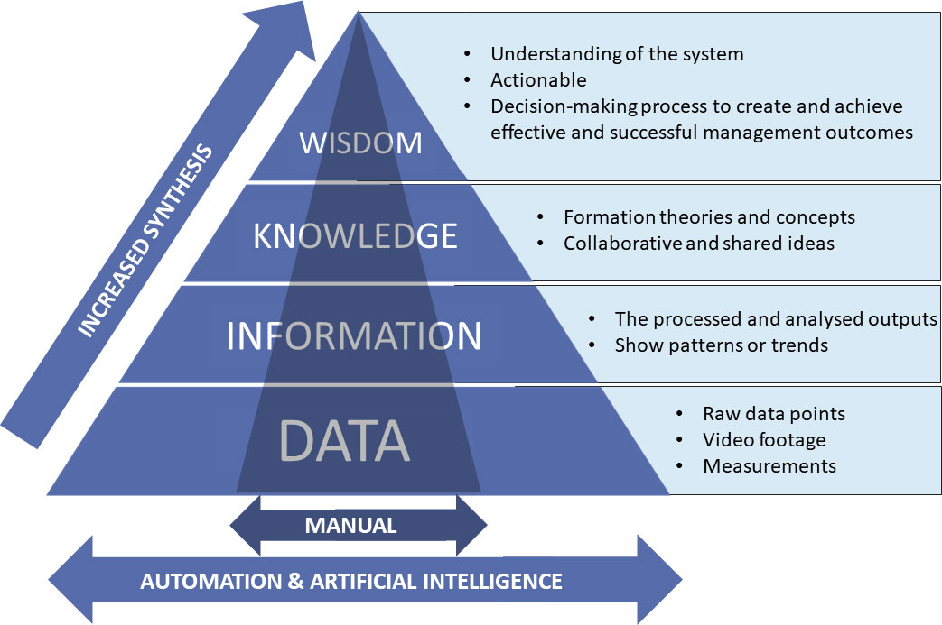
Fig: Implementing AI facilitated, automated methods to collect and process data allowing users to increase the scope, resolution, and breadth of conservation studies$.^{\text{(3)}}$
https://www.frontiersin.org/files/Articles/918104/fmars-09-918104-HTML/image_m/fmars-09-918104-g001.jpg
4/12/2022
LAKE 2022: Conservation of wetlands: ecosystem-based adaptation of climate change, December 28-30, 2022

Slide 9
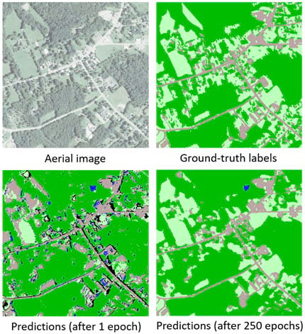
As mentioned earlier UAV’s and Satellites have also played an important role. UAV’s are less cost effective and costlier than Satellites to implement. The data provided by UAV’s are more detailed than that of satellites but cover lesser distance.
4/12/2022
LAKE 2022: Conservation of wetlands: ecosystem-based adaptation of climate change, December 28-30, 2022

Slide 10
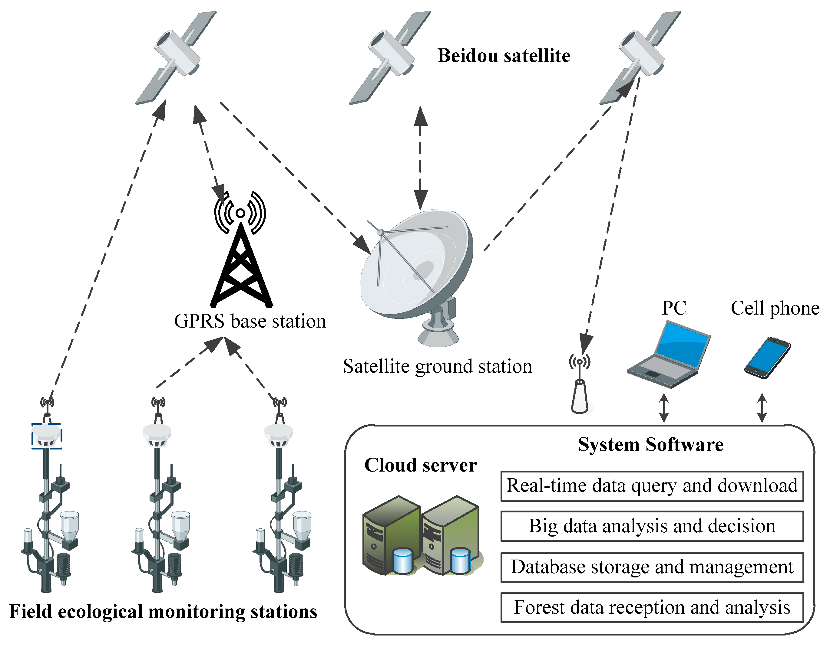
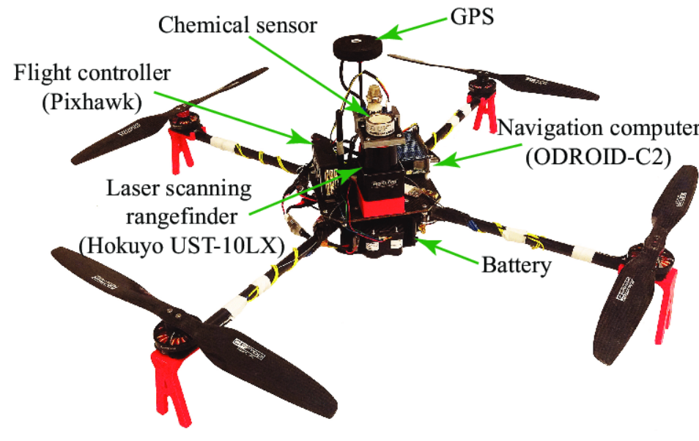
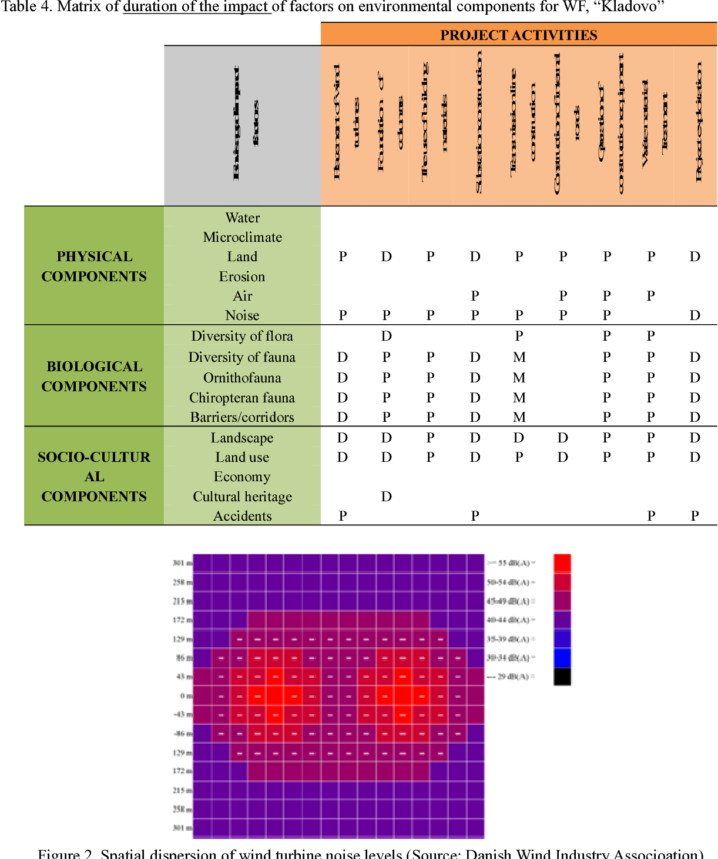
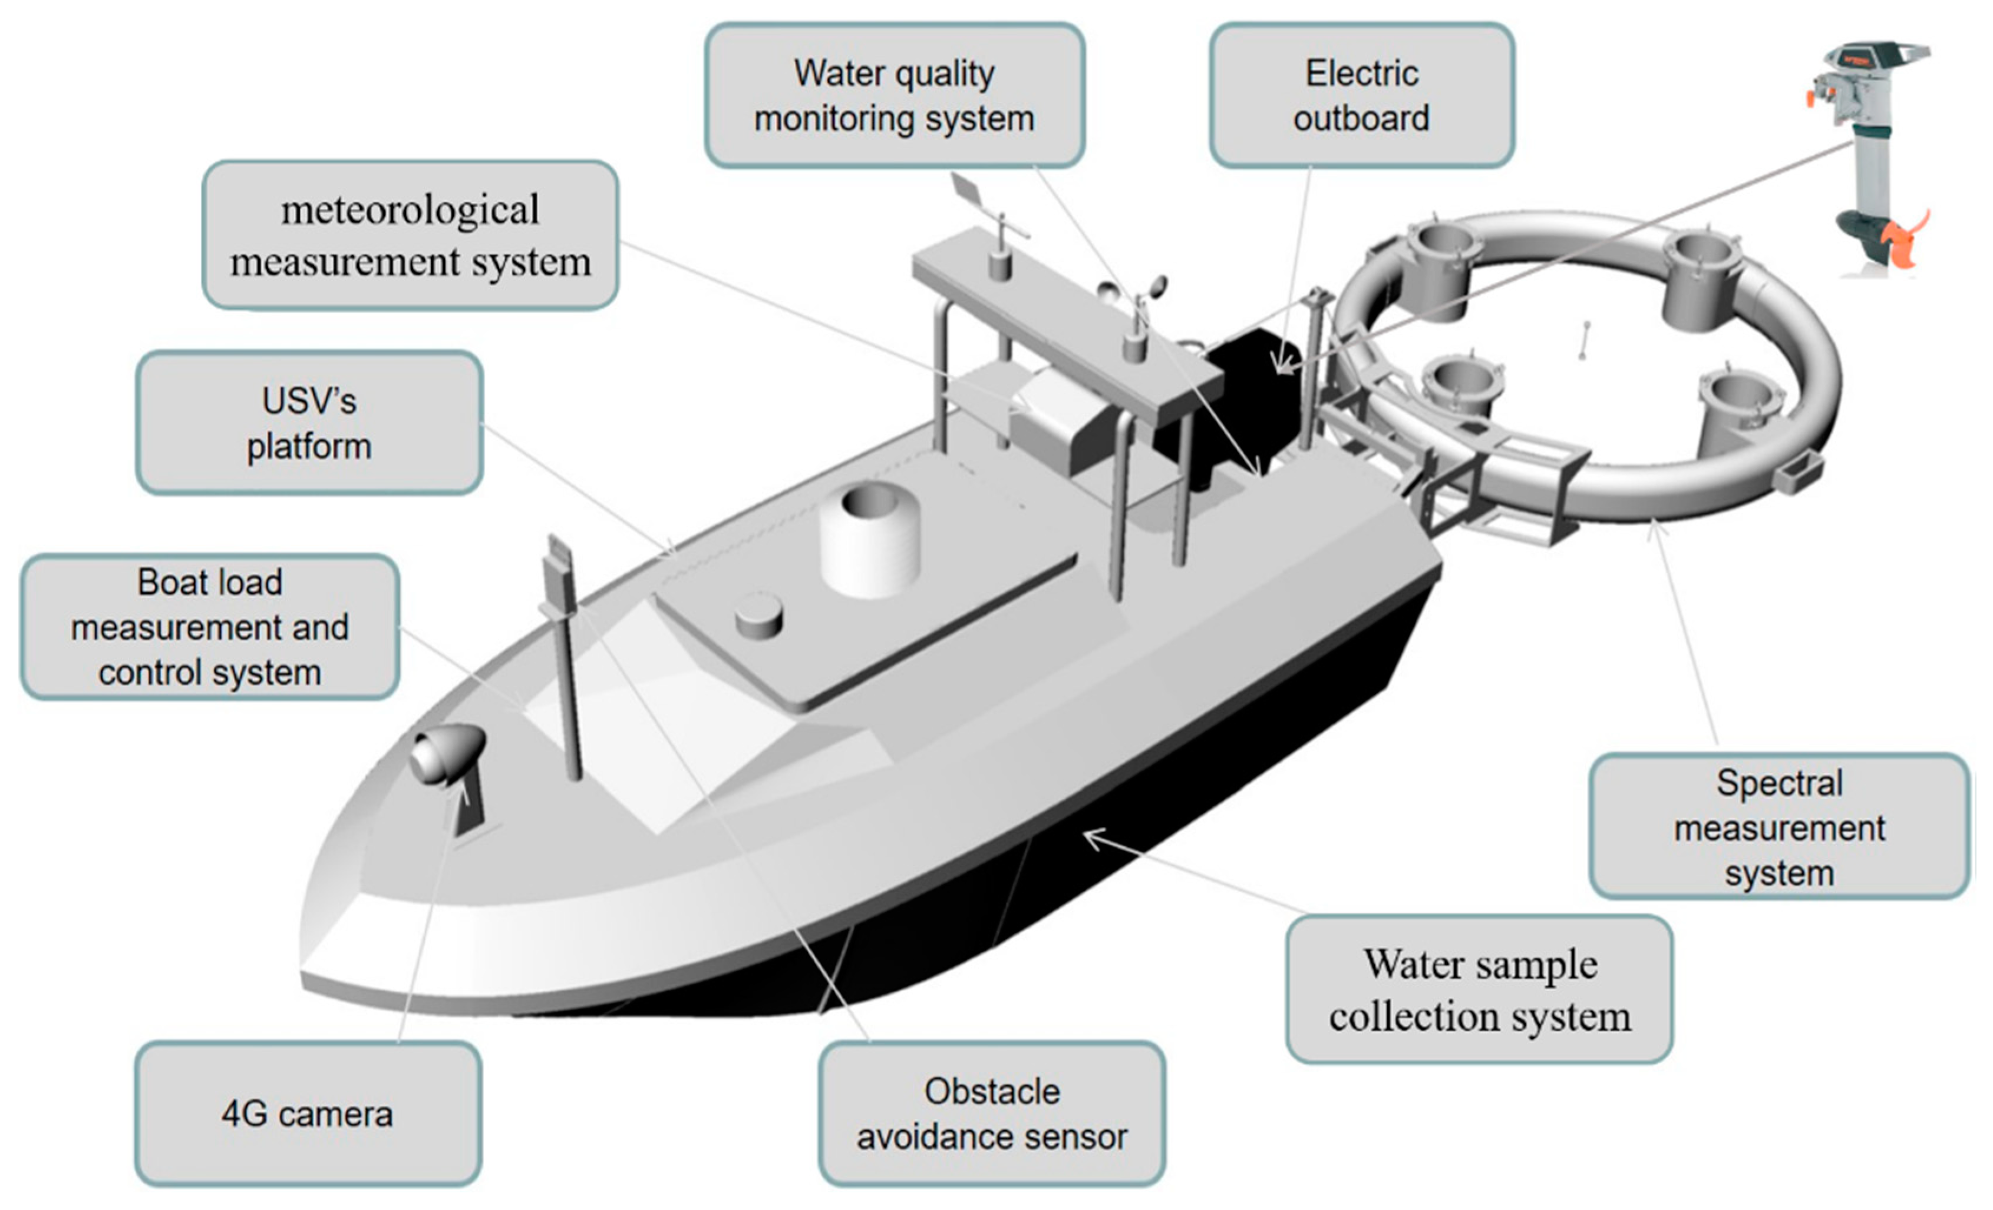
Modern methods
Satellite
UAV
Artificial pieces of technology that float outside of the earth collecting crucial information about our planet
Unmanned aerial vehicles also known as drone which fly over the stipulated area collecting information
Artificial Intelligence
USV
Helps automatically process the information from the above sources
Unmanned sea vehicles that float in the ocean without man support, collecting information
4/12/2022
LAKE 2022: Conservation of wetlands: ecosystem-based adaptation of climate change, December 28-30, 2022

Slide 11
Satellites for data collection
This is based on information from sensors on board artificial satellites.
Advantages:
These cover a large area of land in short spans of time
They are cheaper compared to drone-based imager, but still quite expensive
They provide live data as most areas are almost always under satellite coverage
Disadvantages:
They are sometimes unreliable due to issues like blockage due to clouds.
They have high initial costs and cause air and space pollution and require precision to be launched
4/12/2022
LAKE 2022: Conservation of wetlands: ecosystem-based adaptation of climate change, December 28-30, 2022

Slide 12
Artificial Intelligence
AI refers, broadly, to technology and software with the capacity to perform tasks otherwise requiring human intelligence. There is a gradient of complexity in AI available, from weak AI approaches, such as smartphone applications that assist human-led data collection, to complex machine learning algorithms that can learn to make better predictions by detecting patterns in data.
Deep learning goes one step further than other machine learning techniques by automatically learning and extracting features from data. Deep learning is thus becoming sort-after in monitoring to process raw images, videos, and audio, but we are yet to see its full potential.

Slide 13
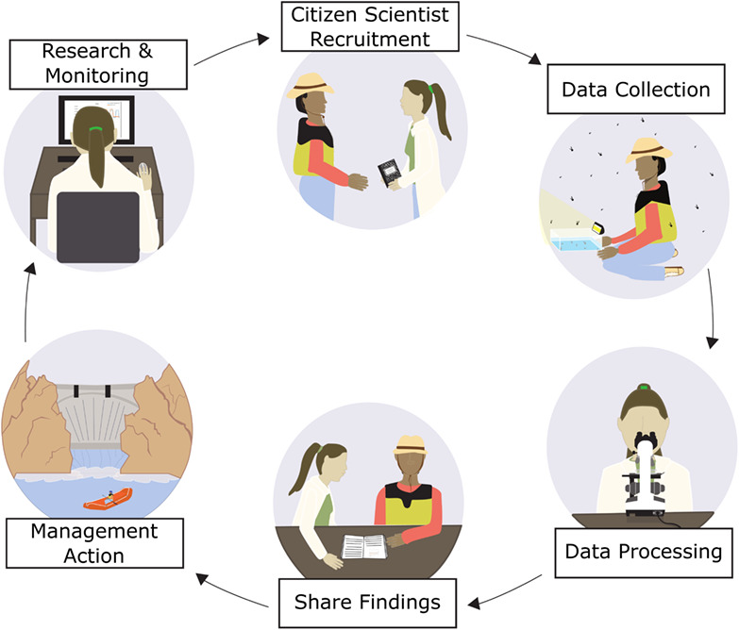
Citizen Science
Citizen science can be described as scientific projects that engage volunteers of varying levels of expertise with scientific research.
These projects produce data usable by a range of stakeholders, across spatial and temporal scales that are otherwise unachievable by conventional means.
Integration of citizen science and AI has the potential to transform monitoring by expediting manual processing and analysis of big data sources, possibly catalysing scientific breakthroughs.
4/12/2022
LAKE 2022: Conservation of wetlands: ecosystem-based adaptation of climate change, December 28-30, 2022
https://wires.onlinelibrary.wiley.com/cms/asset/fbe76454-8597-41d4-adaf-9de7b00c22f6/wat21578-toc-0001-m.jpg

Slide 14
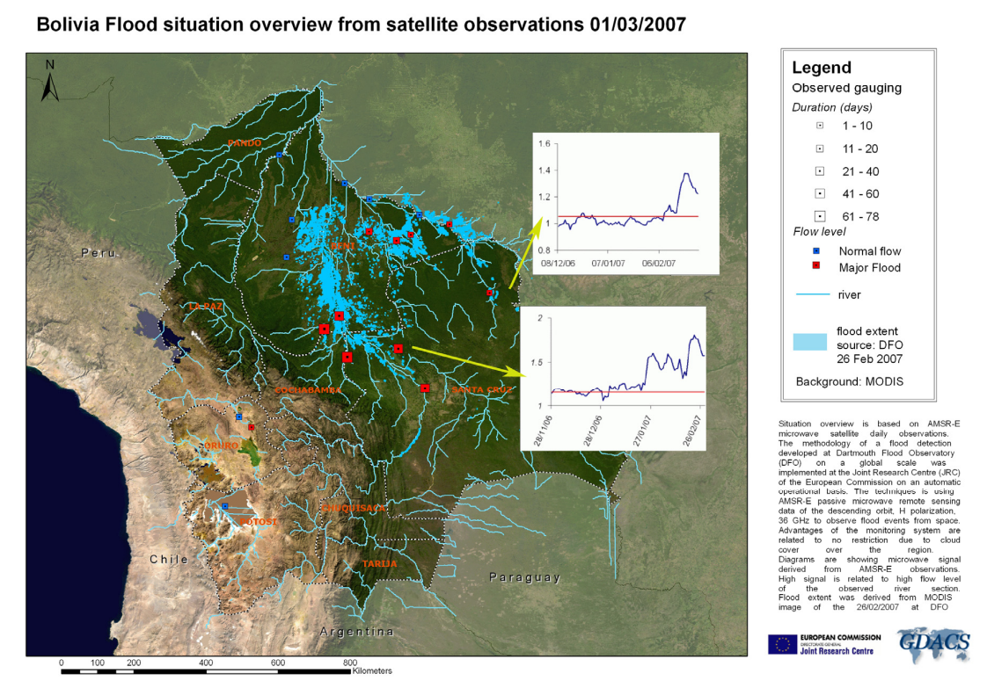
Case Study- Study area
$$:^{(4)(5)}$$
This case study talks in brief about the use of GFDS(Global Flood Detection System) in controlling the Bolivia floods of 2007.
This Latin American country is wedged between the countries of Brazil, Chile, Peru, Paraguay and Argentina and is very rich in mineral deposits and famous for its vast ecosystems.
The main area of flooding in study here revolves around River Mamore and River Grande
4/12/2022
LAKE 2022: Conservation of wetlands: ecosystem-based adaptation of climate change, December 28-30, 2022

Slide 15
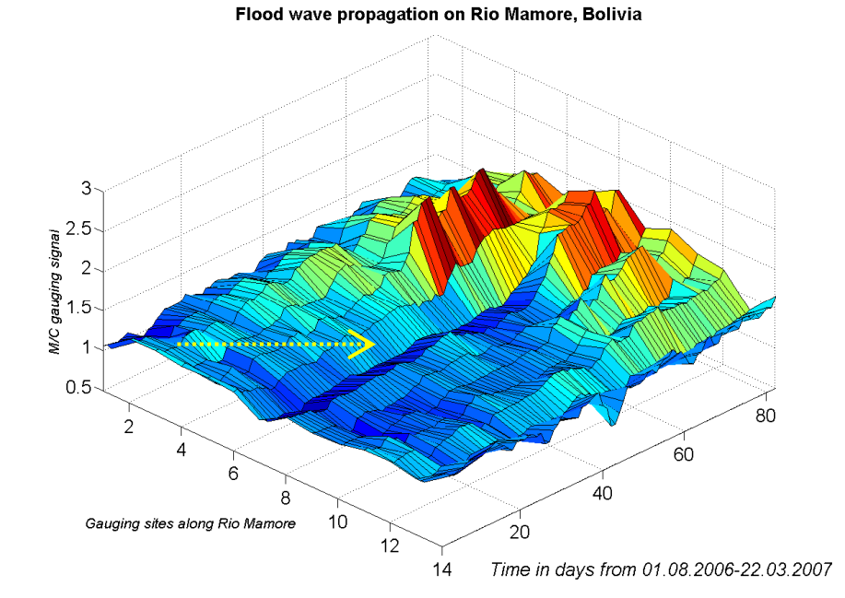
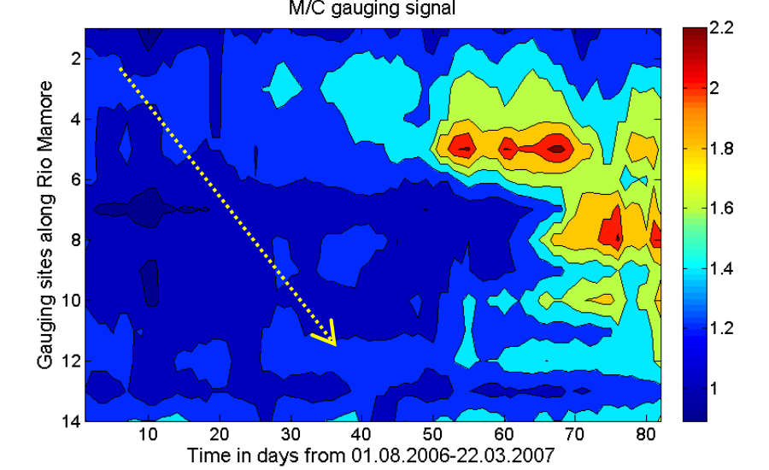
Case Study- Method
The flood came in early 2007 around February because of the El Nino effect.
The data captured was done using the AMSR-E satellite which had a microwave sensor, better than usual optical sensors.
Using these, an interactive map was set up for the public to view
Later, a model was made to predict wave propagations using which flood prone areas were identified and subsequent steps were taken
Although, it is to note that there were a few delays in data due to cloud blockage
The red marks flood situation, blue normal situation and the yellow arrow marks the direction of the wave.
4/12/2022
LAKE 2022: Conservation of wetlands: ecosystem-based adaptation of climate change, December 28-30, 2022

Slide 16
Case Study- Conclusion
This shows a clear case where the use of Satellites along with automated processing allows quick information on natural calamities and helps us monitor data of a specified area .
The Global Flood Detection System provides a systematic monitoring of ongoing flood events around the world updated every day. This fills the gap in lack of global, hydrological data collection.
Especially remote not gauged regions could benefit from the GFDS providing information about current flow status. An overview of the flood situation in many flood emergencies is missing as experienced during the West Africa and Bolivia flood crises.
The high revisit capability of the applied AMSR-E satellite system and the independency of cloud cover enable the technology to acquire information to meet the requirements of operational crisis response.
4/12/2022
LAKE 2022: Conservation of wetlands: ecosystem-based adaptation of climate change, December 28-30, 2022

Slide 17
Implementation of UAVs and AI in India
Flying drones and UAVs are not permitted in Indian wildlife conservation is not allowed due to no-fly zones, but the central ministry has given special permits to certain agencies to allow conservation of ecology using such methods.
Panna Tiger Reserve has started operating a “Drone Squad”. The Drone Squad will be responsible for detecting, locating and informing about wildlife fires, rescue and search of wildlife, avoiding the risk of potential human-animal conflict and ensuring compliance with wildlife conservation laws.
Maharashtra Forest Department have started using drones for one of the biggest threats to wildlife- poaching. Additionally, the department has been using drones for close-watch on tree felling, encroachment and illegal country liquor production.
India shelters around 70% of the world’s tiger population and even though the Bengal tiger is India’s national animal they are listed as endangered in the IUCN Red List. Drones can be used to keep a track on India’s dwindling tiger population.
4/12/2022
LAKE 2022: Conservation of wetlands: ecosystem-based adaptation of climate change, December 28-30, 2022

Slide 18
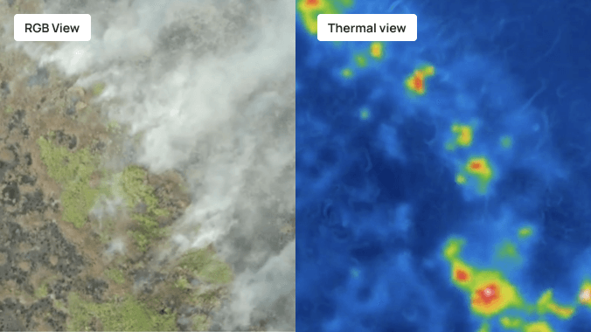
Fig: Use of UAVs for thermal imaging to detect forest fires$.^{\text{(7)}}$

Slide 19
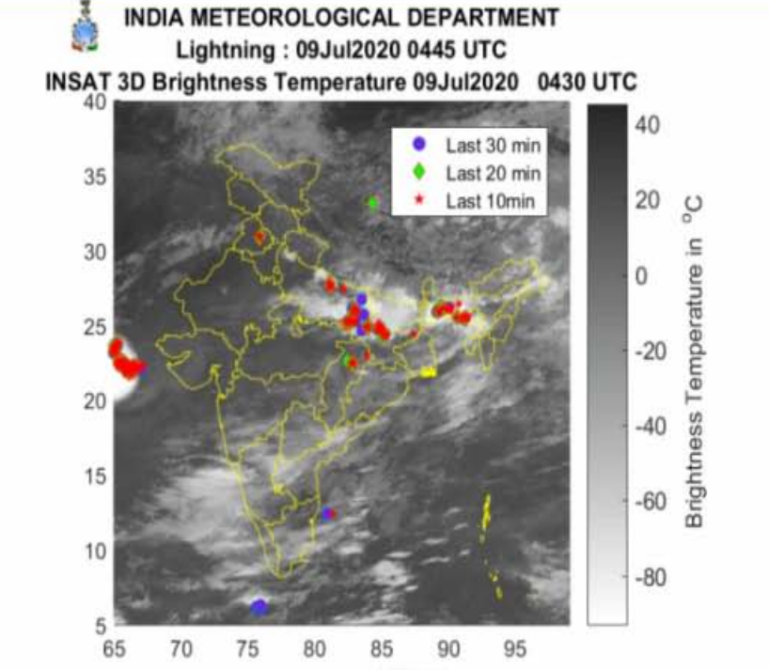
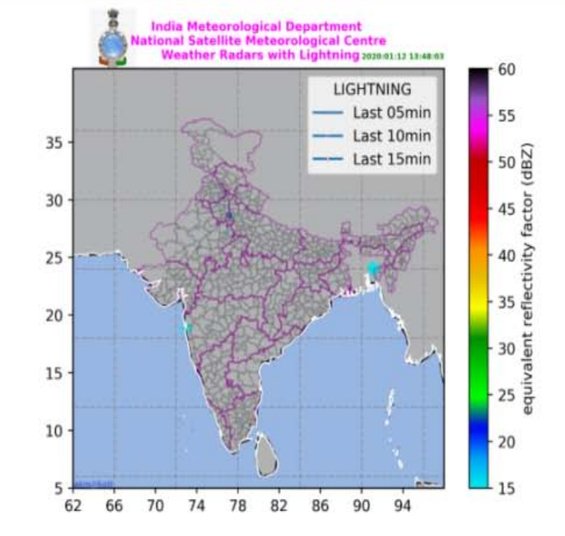
Satellites used for Ecological monitoring
Satellites are cheaper and more cost effective than UAVs and is extensively being used in India.
At present IMD is using Indian Meteorological Geostationary satellites (INSAT-3D&INSAT-3DR), Polar Satellite (Scatterometer Satellite-1 (SCATSat-1), Oceansat-2 & Mega-Tropiques) and International Geostationary Meteorological Satellites (METEOSAT-8 of EUMETSat, Himawari-8 of JMA) data in near real time for weather forecasting through terrestrial EUMETCast system.
ISRO launched the EOS-06 (earth observation satellite) along with eight other nanosatellite payloads on the (Polar Satellite Launch Vehicle) PSLV-C54 mission contained multiple nanosatellites, measuring devices, IoT devices etc. which help in monitoring and accessing data necessary for conservation.
(9)
Fig: Monitoring Weather using Satellites
(8)
4/12/2022
LAKE 2022: Conservation of wetlands: ecosystem-based adaptation of climate change, December 28-30, 2022

Slide 20
Acknowledgement
We would like to thank IISc for this wonderful opportunity.
This would not have been possible without the support of our school; the wonderful R &D department along with all the teachers and our respected principal Smt. Padma Sagar.
We would like to express our special thanks to our guide throughout the project Smt. Sindhu R.
4/12/2022
LAKE 2022: Conservation of wetlands: ecosystem-based adaptation of climate change, December 28-30, 2022

Slide 21
References
(1)- https://upload.wikimedia.org/wikipedia/commons/1/1f/20210331_Global_tree_cover_loss_-_World_Resources_Institute.svg
(2)- https://ourworldindata.org/uploads/2022/03/Annual-World-Population-since-10-thousand-BCE-2048x1441.png
(3)- https://www.frontiersin.org/files/Articles/918104/fmars-09-918104-HTML/image_m/fmars-09-918104-g001.jpg
(4)- https://floodobservatory.colorado.edu/Publications/GlobalFloodDetectionSystem.pdf
(5)- https://en.wikipedia.org/wiki/Bolivia
(6)-https://earthobservatory.nasa.gov/images/19616/floods-in-Bolivia
(7)- https://www.borneonaturefoundation.org/news/thermal-drone-new-technology-to-detect-fires/
(8)- https://mausam.imd.gov.in/imd_latest/contents/pdf/forecasting_sop.pdf
(9)- https://theprint.in/science/taking-off-today-isro-mission-is-good-news-for-radio-enthusiasts-environment-monitoring/1235717/
https://www.frontiersin.org/articles/10.3389/fmars.2022.918104/full
https://www.unep.org/news-and-stories/story/how-artificial-intelligence-helping-tackle-environmental-challenges
https://link.springer.com/article/10.1134/S1067413615010038
https://www.mdpi.com/2071-1050/14/12/7154
https://theprint.in/science/taking-off-today-isro-mission-is-good-news-for-radio-enthusiasts-environment-monitoring/1235717/
https://mausam.imd.gov.in/imd_latest/contents/pdf/forecasting_sop.pdf
4/12/2022
LAKE 2022: Conservation of wetlands: ecosystem-based adaptation of climate change, December 28-30, 2022

Slide 22
Thank you
4/12/2022
LAKE 2022: Conservation of wetlands: ecosystem-based adaptation of climate change, December 28-30, 2022

